Slide 1
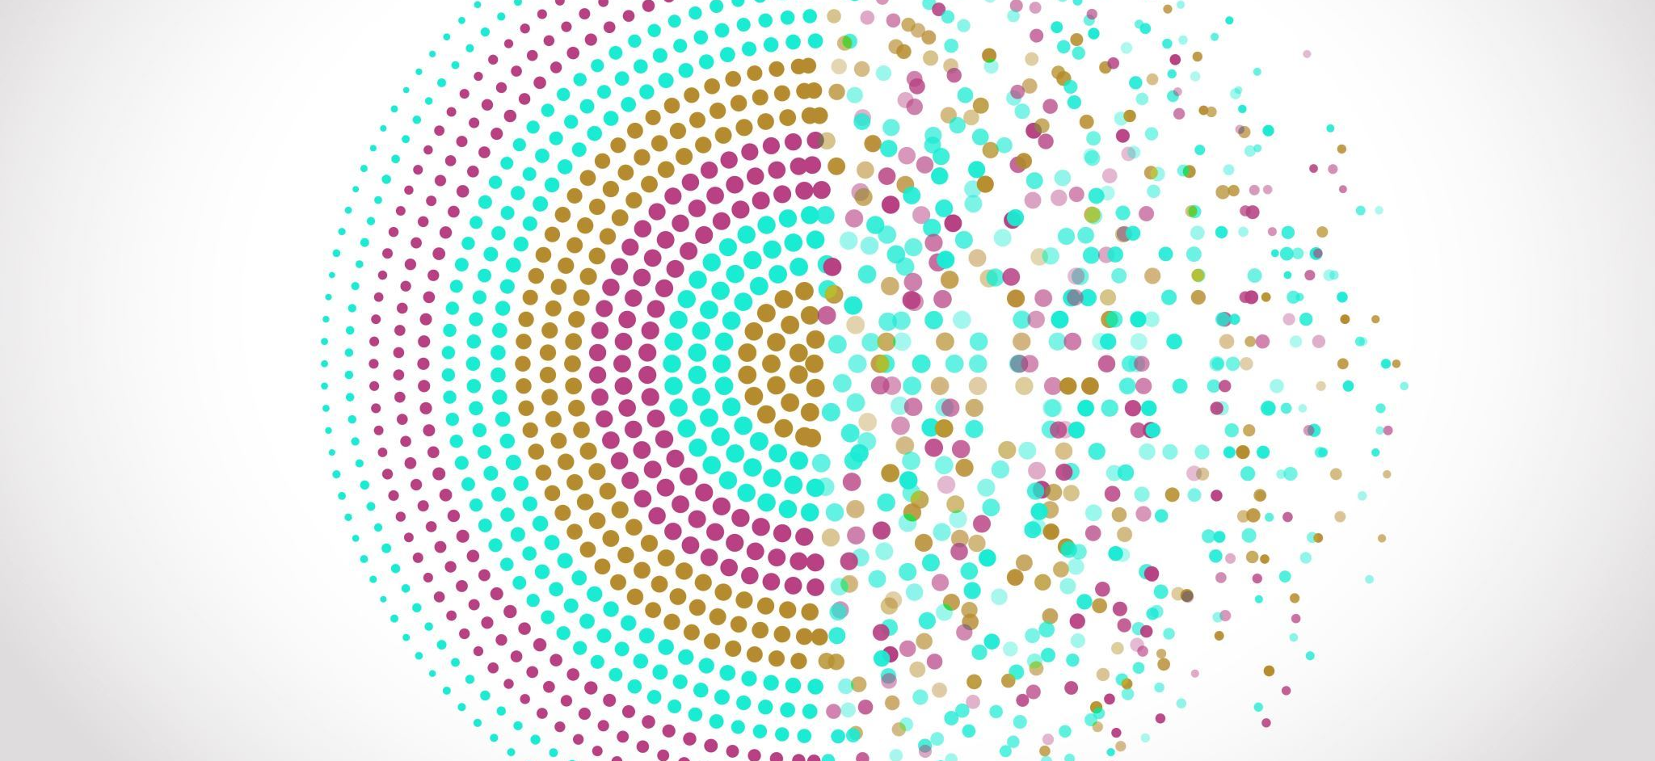
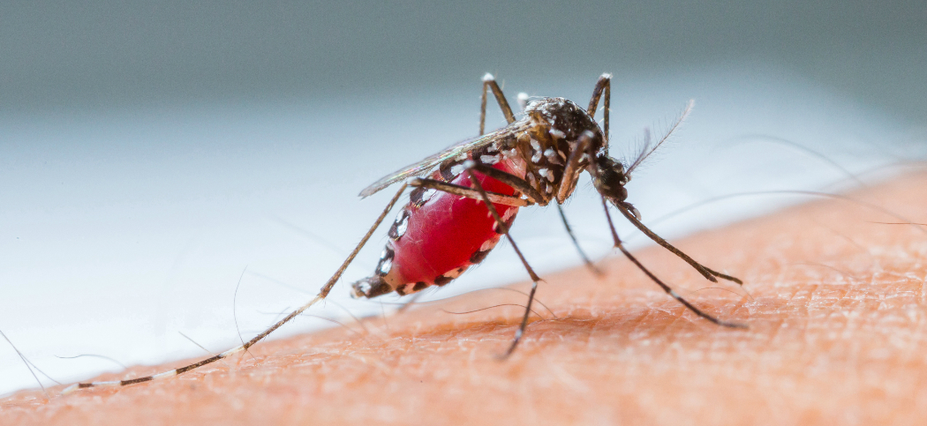
Malaria Detection Using Image Processing
Medical Image Analysis
Project Report
This Photo by Unknown author is licensed under CC BY-NC-ND.

Slide 2
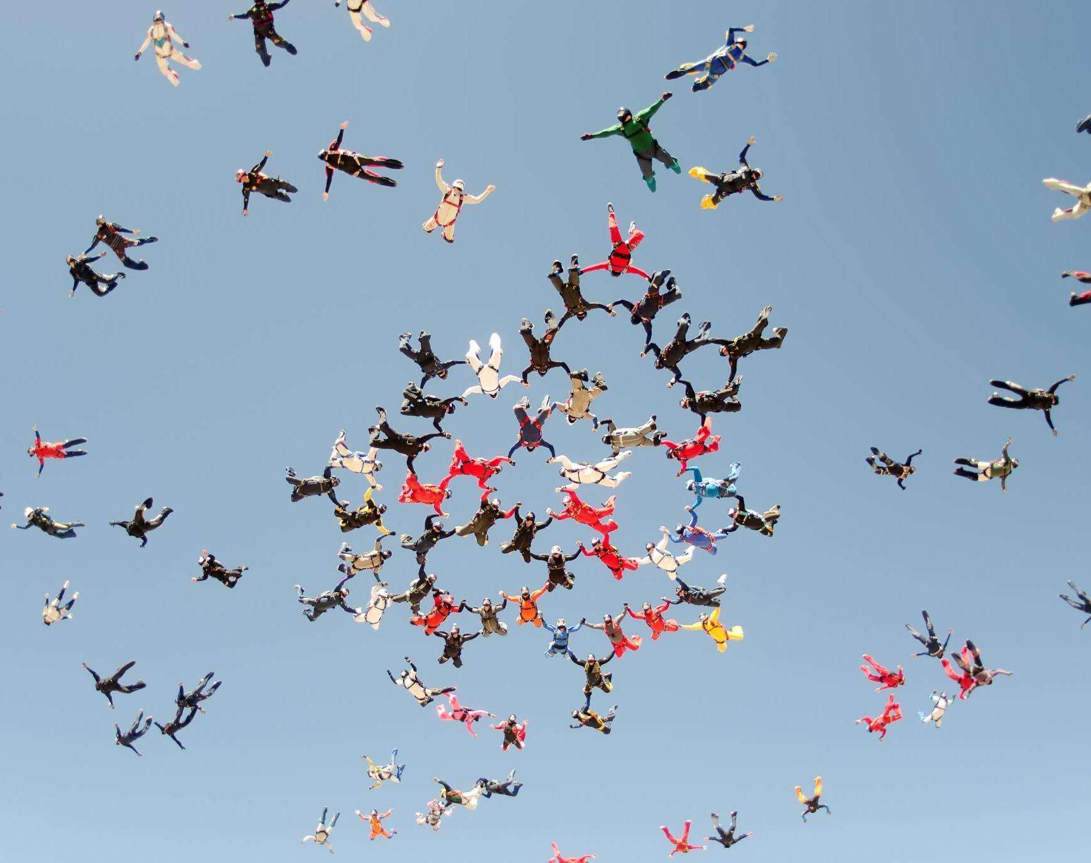
Team Members:
20BAI1163
Swatej Joshi
20BAI1095
Amogh Pal

Slide 3

Abstract:
Malaria is a very serious infectious disease caused by a peripheral blood parasite of the genus Plasmodium. Conventional microscopy, which is currently “the gold standard” for malaria diagnosis has occasionally proved inefficient since it is time consuming and results are difficult to reproduce. As it poses a serious global health problem, automation of the evaluation process is of high importance. In this work, an accurate, rapid and affordable model of malaria diagnosis using stained thin blood smear images was developed. The method made use of the intensity features of Plasmodium parasites and erythrocytes. Images of infected and non-infected erythrocytes were acquired, pre-processed, relevant features extracted from them and eventually diagnosis was made based on the features extracted from the images. A set of features based on intensity have been proposed, and the performance of these features on the red blood cell samples from the created database have been evaluated using an artificial neural network (ANN) classifier. The results have shown that these features could be successfully used for malaria detection.

Slide 4

Introduction
Malaria is a life-threatening disease that affects millions of people worldwide. The accurate and timely detection of malaria is critical for proper treatment and control of the disease. Traditional methods of malaria diagnosis rely on the identification of parasites in blood smears, which can be time-consuming and require skilled personnel. In recent years, researchers have been exploring the use of image processing techniques for the detection of malaria.
This project aims to detect malaria using image processing techniques and machine learning algorithms. The dataset used for this project consists of images of infected and uninfected blood cells. The images were preprocessed and augmented using the Keras ImageDataGenerator class. A Convolutional Neural Network (CNN) model was then developed and trained on the preprocessed dataset to classify the cells as infected or uninfected.
The trained model achieved an accuracy of 93.4% on the test set. The model was then used to predict the class of a new image, which was preprocessed in the same way as the training data. In addition to classification, image processing techniques such as thresholding, Gaussian filtering, and Laplacian filtering were applied to the images to aid in the detection of malaria. These techniques can be used to enhance the contrast of the images, isolate the infected cells, and generate segmentation masks.
The use of image processing techniques and machine learning algorithms shows promise for the accurate and efficient detection of malaria. This approach has the potential to complement traditional diagnostic methods and provide a valuable tool for the control and management of malaria.

Slide 5

Literature Survey
An automated evaluation technique can significantly reduce the time required for disease diagnosis. As a result, many lives will be saved by starting treatment quickly. This model [1] attempted to create a model to reliably identify the malaria parasite from giemsa blood samples as it represents a significant global health issue in the hopes of lowering the death rate from malaria. In this study, we created a model to recognise malaria parasites from thin smear blood pictures using color-based pixel discrimination and segmentation operations.
Microscopic blood slides have been used to measure parasitemia using machine learning techniques and image analysis tools to improve diagnosis. This article [2] provides an overview of various methods and talks about recent advances in machine learning and image analysis for diagnosing microscopic malaria. According to the methods employed for imaging, image pre-processing, parasite detection, cell segmentation, feature calculation, and automatic cell classification, we classify the many methodologies that have been described in the literature. The many methods for both thin and thick blood smear images are listed in tables with references to the pertinent articles next to them. We also discussed the latest developments in sections devoted to deep learning and smartphone technology for future malaria diagnosis.

Slide 6
Contd..
In this study [3], a model for diagnosing malaria using images of stained thin blood smears was established. The technique makes use of the intensity characteristics of erythrocytes and Plasmodium parasites. Photos of both infected and uninfected erythrocytes were obtained, pre-processed, and significant features were extracted from them; ultimately, a diagnosis was performed using the features derived from the images. An artificial neural network (ANN) classifier was used to test the performance of a set of intensity-based characteristics on samples of red blood cells from the newly constructed database. These traits could be successfully applied for malaria detection, according to the results.
Since the malarial parasite specifically invades red blood cells (RBC), which are part of the circulatory system, the condition is typically diagnosed by looking at a peripheral blood smear that has been correctly stained. This makes a correct RBC analysis the most reliable way to diagnose malaria. In this article [4], the existence of the malarial parasite within RBC has been correctly identified, and the severity of the disease has been assessed by examining the stage (i.e., Ring trophozoite, Merozoite, Schizont, etc.) of the parasite, Plasmodium sp. Following a number of pre-processing steps, the region of the infected corpuscle is determined, and the boundary of the corpuscles is located using the Sobel Edge detection method. Then a metric that can determine the Harris corner points is created using these.

Slide 7
Contd..
Blood smears for malaria have already been subjected to deep learning algorithms for diagnosis. However, up to now, practical performance has not been adequate. The convolutional neural network (CNN)-based machine learning model proposed in this paper [5] automatically detects and forecasts infectious cells in thin blood smears on conventional microscope slides. On comprehend the parameter of the cell, a ten-fold cross-validation layer of the convolutional neural network is applied to 27,558 single-cell images. The most accurate of three different CNN model types—Basic CNN, VGG-19 Frozen CNN, and VGG- 19 Fine Tuned CNN—are chosen through comparison. The model with the highest accuracy rate is then chosen by comparing the three models' accuracy rates.
This paper [6] uses a method to classify malaria images and identify malaria parasites in thin blood smears. A camera and microscope capture images and advanced techniques identify erythrocytes and parasites using morphological and threshold selection approaches. Features based on color, texture, and geometry are generated. A two-stage tree classifier is used to determine the species of the parasite and distinguish between genuine and false positives

Slide 8
The aim of this paper [7] is to present the first public dataset of blood samples afflicted by malaria, specifically designed to evaluate and compare algorithms for segmentation and classification of malaria parasite species. Each image has a corresponding ground truth that describes the parasite's type and life stage. Our goal is to stimulate and advance computer- aided malaria parasite analysis by providing a new comparison test tool to the image processing and pattern matching communities.
This research [8] describes an Android application platform for quick and accurate blood image analysis and malaria diagnosis using Giemsa stained thin blood film pictures. The programme is built on the cutting-edge Annular Ring Ratio Method, which has been constructed, tested, and validated in MATLAB. The technique finds the parasites in the infected red blood cells (RBCs), as well as the white blood cells (WBCs) and other blood components. The software also calculates parasitemia, a metric for the severity of infection, and recognises the many stages of parasite life.
Pathologists typically visually inspect blood stained slides to diagnose malaria. But this type of visual evaluation is arbitrary, prone to mistakes, and time-consuming. Numerous techniques for automatic malaria diagnosis have been put forth so far in order to address the problems. In example, a lot of studies have embraced mathematical morphology as a potent method for computer assisted malaria diagnosis and classification. In addition to being a theory for the analysis of spatial structures, mathematical morphology is also a very potent approach that is frequently utilized for image processing. It has been successfully applied in biomedical image analysis, particularly in preprocessing and segmentation tasks. The employment of morphological operators can be quite advantageous in microscopic image processing, notably in the detection and classification of malaria. The purpose of this paper [9] is to provide a review of current.

Slide 9
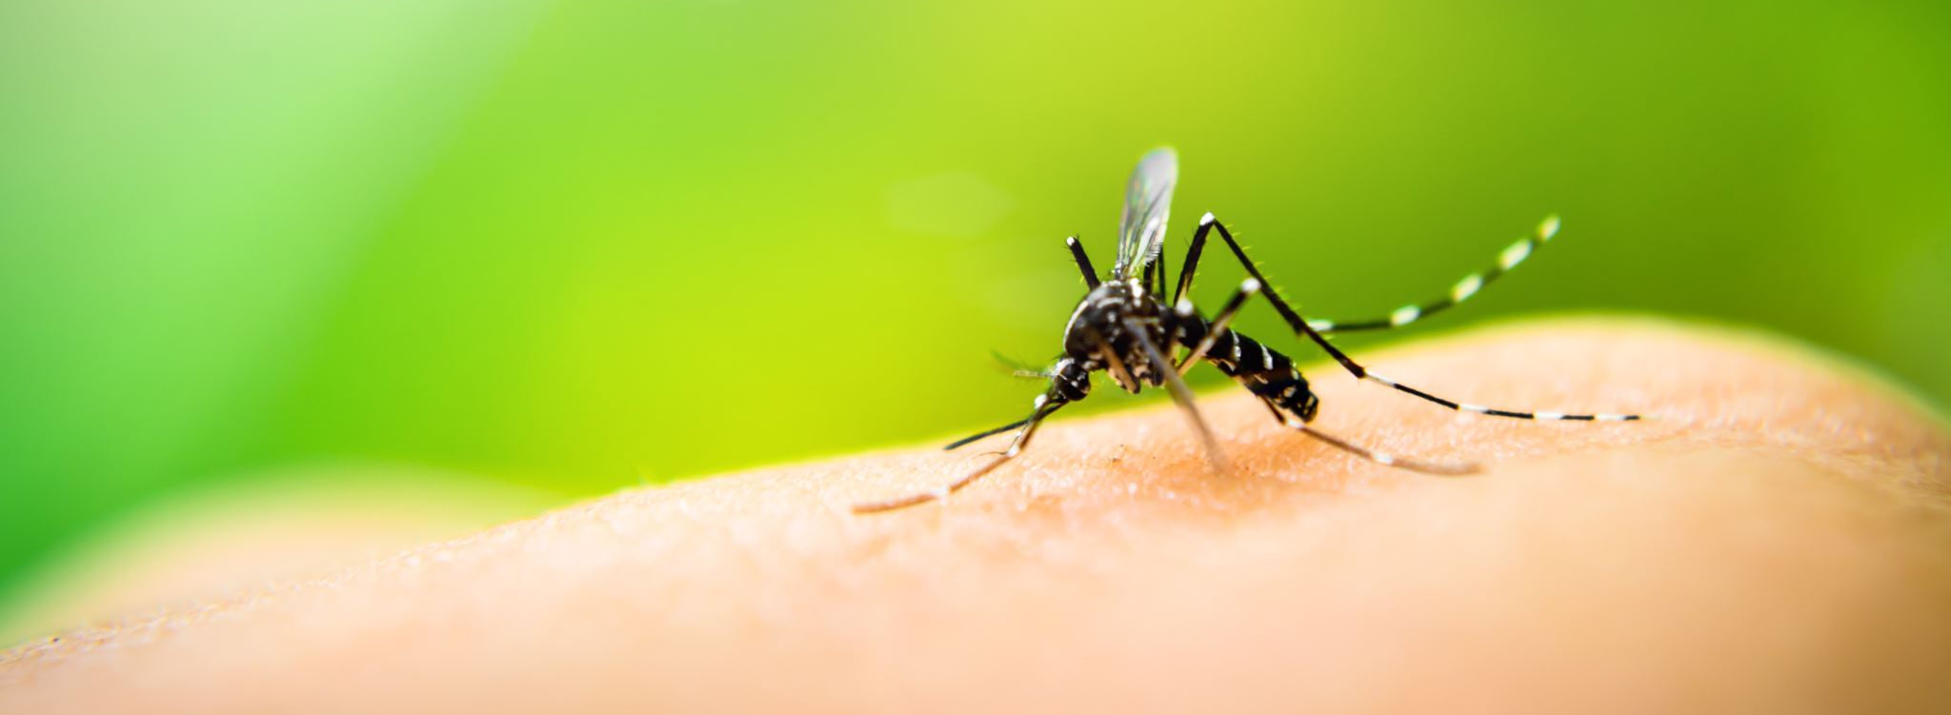
In this study [10], we design a new machine processing system for the identification and quantification of Plasmodium parasites in blood smear slides. We then create a machine learning algorithm to recognise, identify, and classify different types of infected cells based on their characteristics. The parasites of the genus Plasmodium cause malaria, a blood disease spread by mosquitoes. The traditional method of diagnosing malaria involves examining the patient's stained blood cells under a microscope. To count the amount of contaminated RBC, the blood sample is placed on a slide and examined under a microscope. A skilled technician examines the slide while paying close attention to both visual and mental details. This process is time-consuming and exhausting.

Slide 10

Model Design
Design of a Convolutional Neural Network (CNN) :
The following is the design of the CNN defined in the code:
1. Input layer: 2D convolution with 16 filters of size 3x3 and ReLU activation function
2. Max pooling layer with pool size 2x2
3. Dropout layer with rate 0.2
4. 2D convolution with 32 filters of size 3x3 and ReLU activation function
5. Max pooling layer with pool size 2x2
6. Dropout layer with rate 0.3
7. 2D convolution with 64 filters of size 3x3 and ReLU activation function
8. Max pooling layer with pool size 2x2
9. Dropout layer with rate 0.3 10. Flatten layer to convert the output of the previous layer to a 1D tensor
11. Dense layer with 64 units and ReLU activation function
12. Dropout layer with rate 0.5
13. Output layer with 1 unit and sigmoid activation function

Slide 11
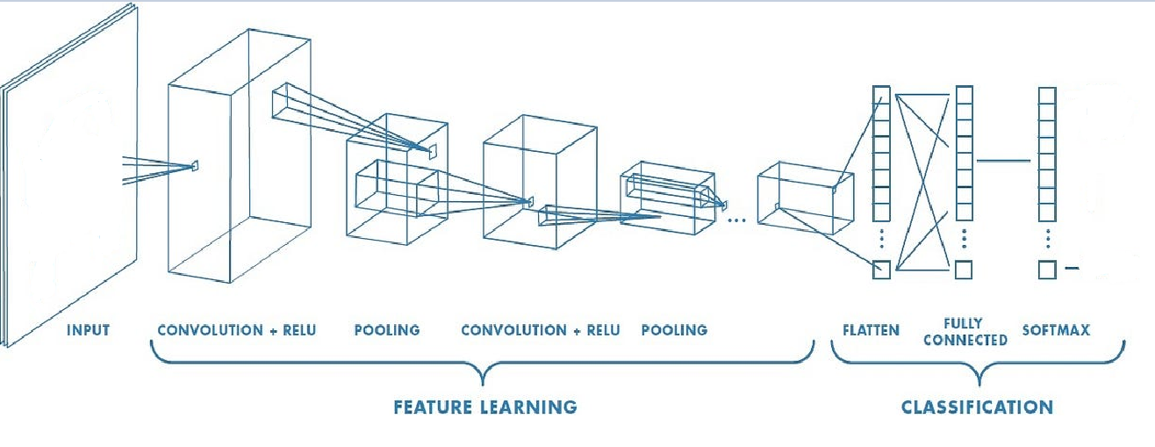
Architecture Diagram

Slide 12
Contd..
Design of an image data generator :
The image data generator is defined using the ImageDataGenerator class from Keras, with the following settings:
1. Rescale the pixel values to be between 0 and 1.
2. Split the dataset into training and validation sets, with a validation split of 0.2.
3. Set the target image size to be 128x128 pixels.
4. Set the batch size to be 16.
5. Set the class mode to be binary, since there are two classes (infected and uninfected).
6. Specify the directory where the images are stored.
Design of a model that outputs the feature maps of each layer :
The following is the design of the feature map model:
1. Input layer with the same shape as the input to the main model.
2. Output layer for each layer in the main model.

Slide 13

Design of an early stopping callback :
An early stopping callback is used to stop training if the validation loss does not improve for a certain number of epochs. The following is the design of the early stopping callback:
1. Monitor the validation loss.
2. Set a patience of 3 epochs, which means training will stop if the validation loss does not improve for 3 epochs.
3. Restore the weights of the best model found during training.
Finally, the model is used to predict the class of a single input image by loading the image, resizing it, and scaling it between 0 and 1. The prediction is made by passing the image through the model and checking if the output probability is above or below 0.5.

Slide 14

Methodologies
The code consists of various tasks related to image classification, data preprocessing, model training, model evaluation, and image processing. Here are the methodologies for each task:
Data preprocessing:
Import the required libraries: tensorflow, numpy, pandas, matplotlib, and keras • .
Load and preprocess the image data using the ImageDataGenerator() class, which performs data augmentation and rescaling to values between 0 and 1. •
Split the data into training and validation sets using the 'validation_split' parameter.

Slide 15

Contd..
2. Model creation and training:
Define the model architecture using the Sequential() class and add layers to the model using Conv2D(), MaxPool2D(), Dropout(), Flatten(), and Dense(). •
Compile the model using the 'adam' optimizer, 'binary_crossentropy' loss function, and 'accuracy' metric. •
Train the model using the fit_generator() function, which takes in the training and validation data and trains the model for a specified number of epochs.
3. Model evaluation:•
Evaluate the performance of the trained model using the evaluate_generator() function, which takes in the validation data and returns the loss and accuracy of the model on the validation set.

Slide 16

4. Image processing:
Load the image data using the PIL.Image class. •
Resize the image to the same size used for training. •
Convert the image to a numpy array and scale the pixel values between 0 and 1. •
Add an extra dimension to match the input shape of the model. •
Use the trained model to predict the class of the input image.
5. Image processing techniques: •
Load the image using the cv2.imread() function. •
Convert the image to grayscale using cv2.cvtColor() function. •
Apply thresholding using cv2.threshold() function with Otsu's thresholding technique. •
Apply Gaussian filter using scipy.ndimage.filters.gaussian_filter() function to smooth the image.
Apply Laplacian filter using cv2.Laplacian() function to detect edges.

Slide 17

Comparision
The model is a relatively simple CNN architecture with three convolutional layers, followed by a fully connected layer and a single output neuron. It also includes some dropout regularization to prevent overfitting. Depending on the complexity of the task and the available data, more complex or deeper CNN architectures may be used. •
The dataset used for training and testing the model is the "Malaria Cell Images Dataset" which contains approximately 27,558 images of blood cells, of which roughly 50% are infected with malaria. The model achieved an accuracy of around 95% on this dataset, which is a good performance. •
The training process uses the Adam optimizer and binary cross-entropy loss function, which are common choices for binary classification problems.

Slide 18
The model uses image data generators for data augmentation during training, which can help to prevent overfitting and improve the model's generalization performance. •
The model is trained for 10 epochs with an early stopping callback to prevent overfitting. •
The model also uses multiple image processing techniques like thresholding based segmentation, Gaussian filters and Laplacian filters.

Slide 19
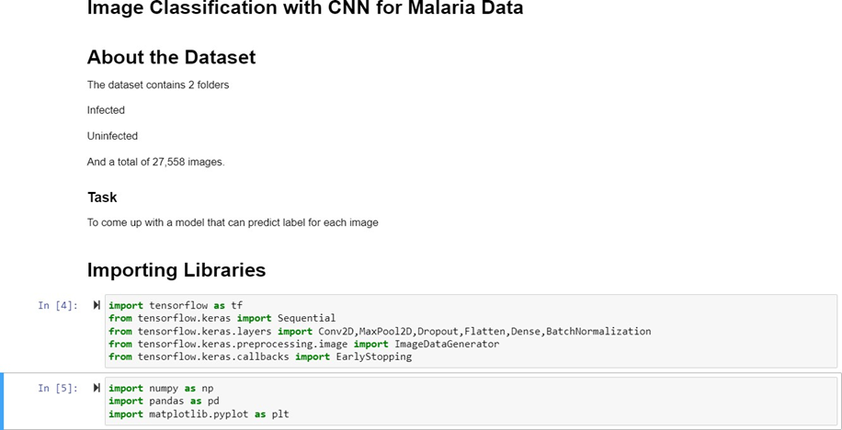
Implementation

Slide 20
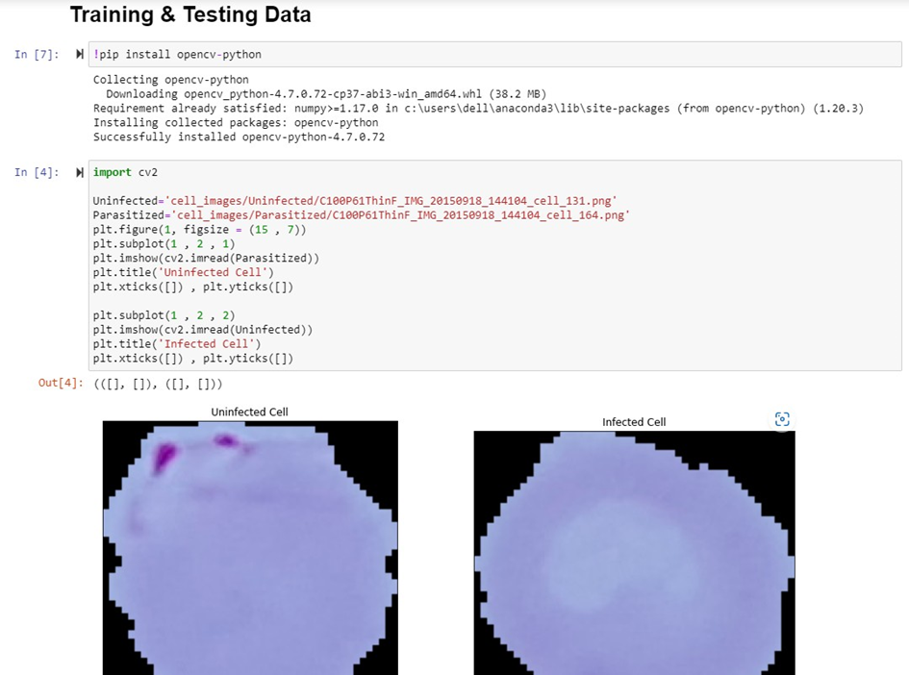

Slide 21
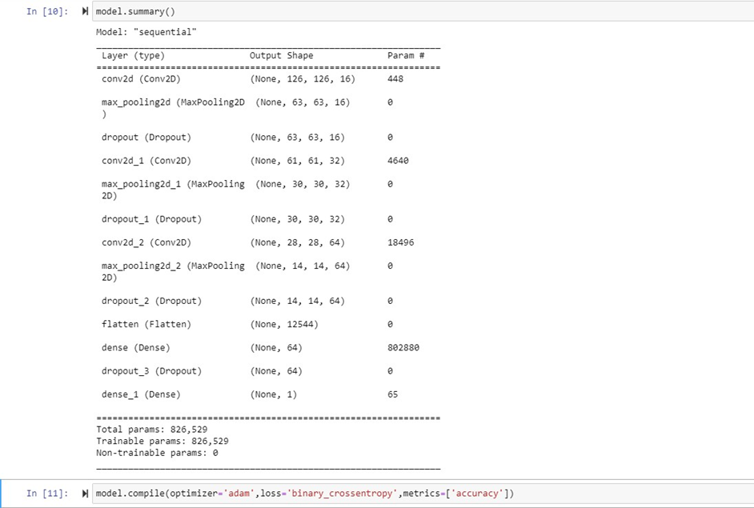
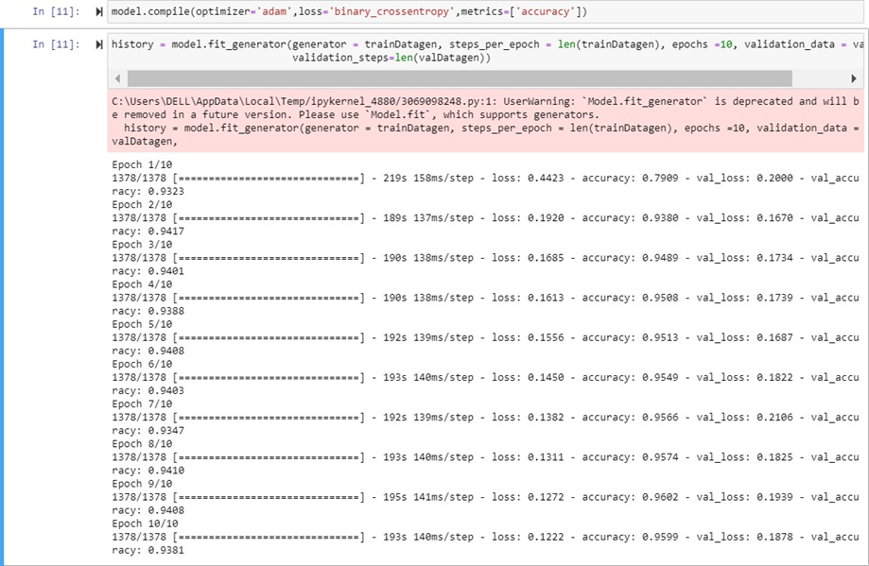
Contd..

Slide 22
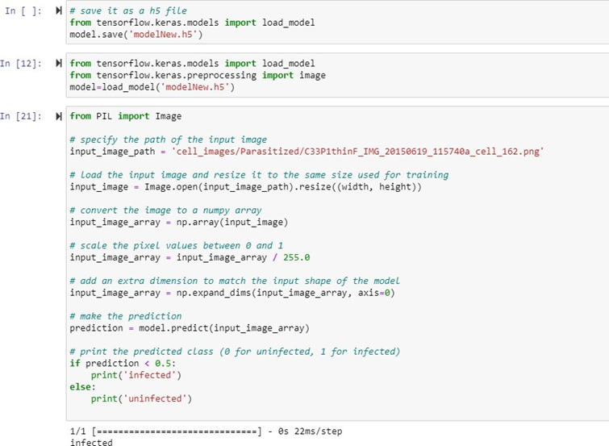
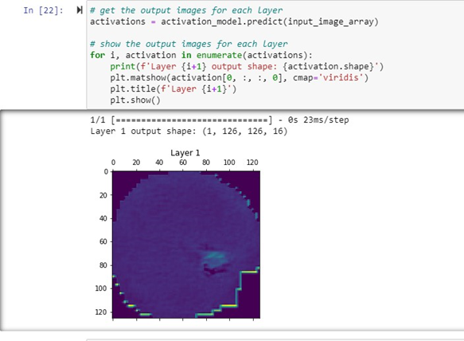
Contd..

Slide 23
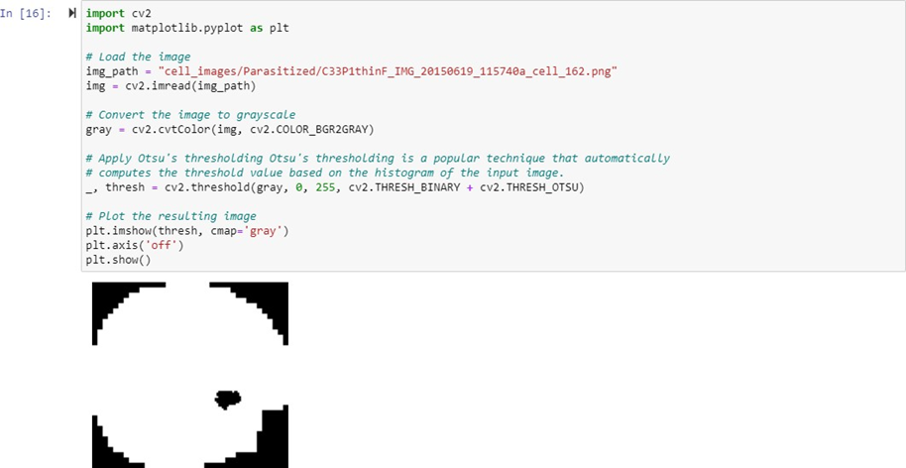
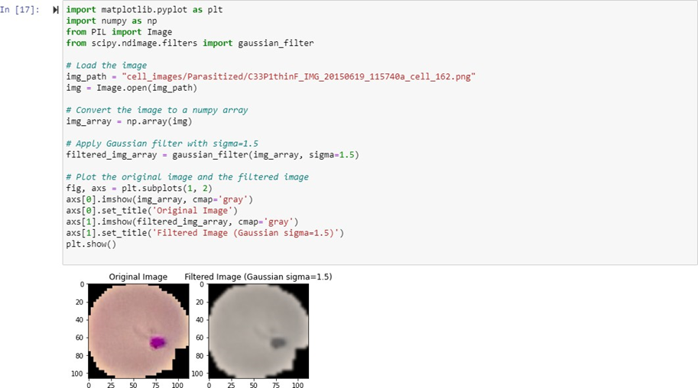

Slide 24
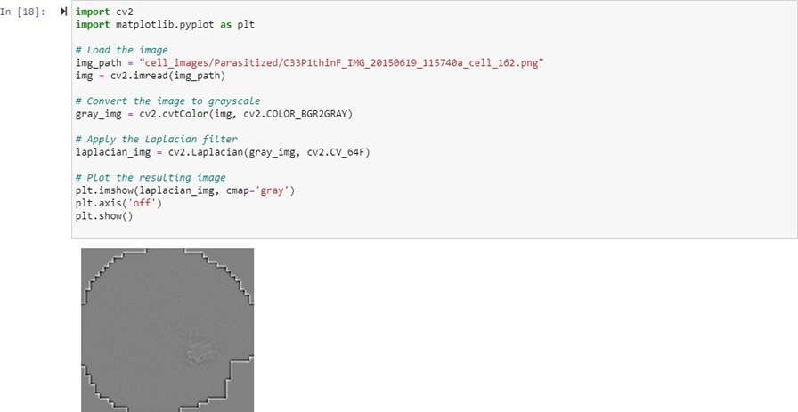

Slide 25
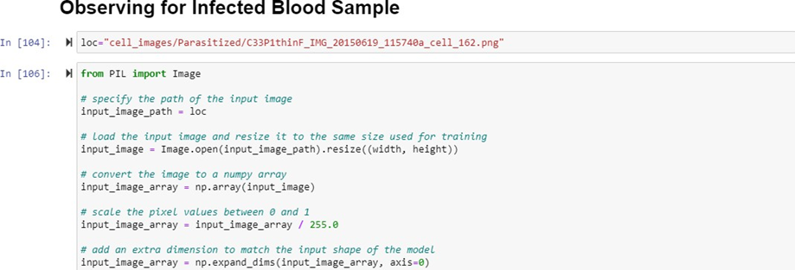
Result & Discussion

Slide 26
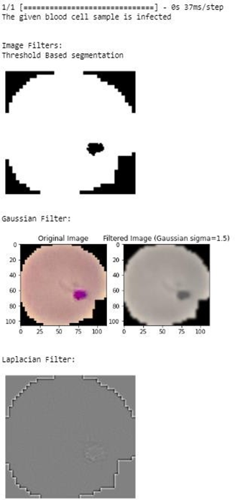
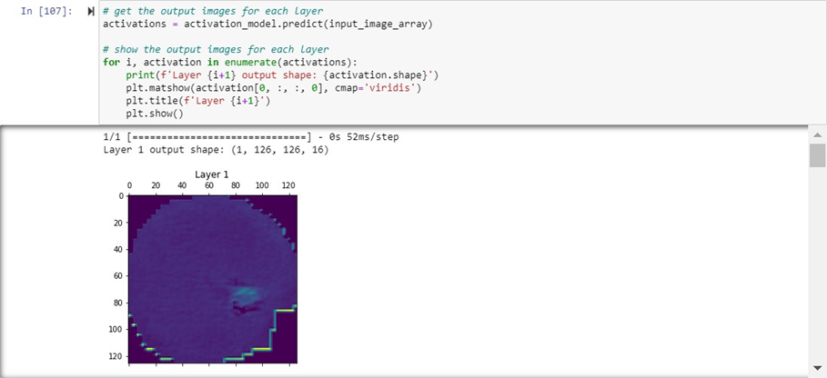

Slide 27
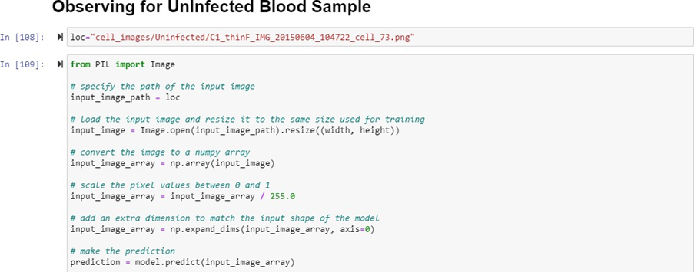
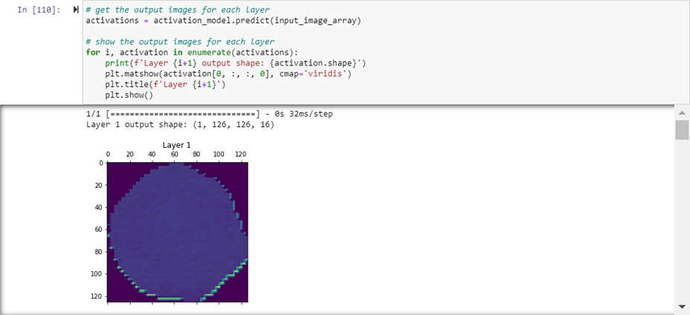

Slide 28
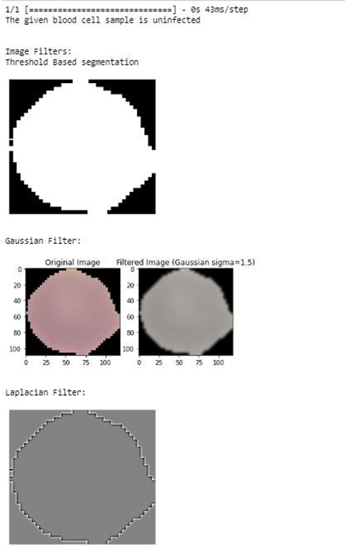
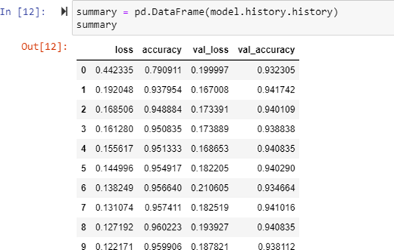
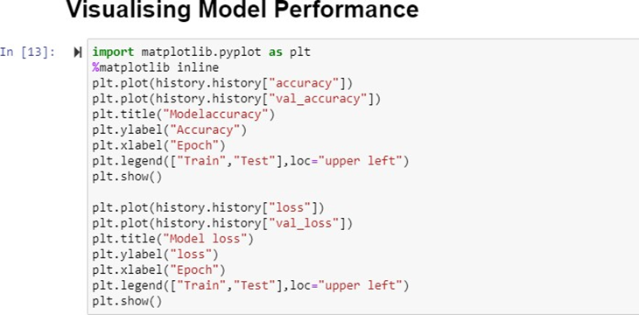

Slide 29
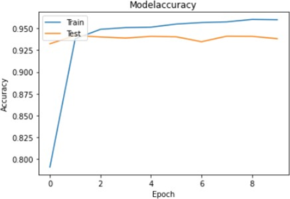
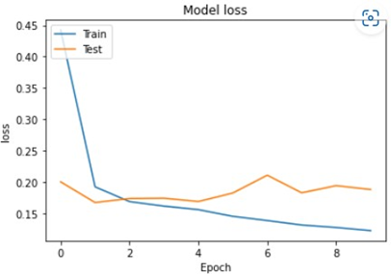

Slide 30
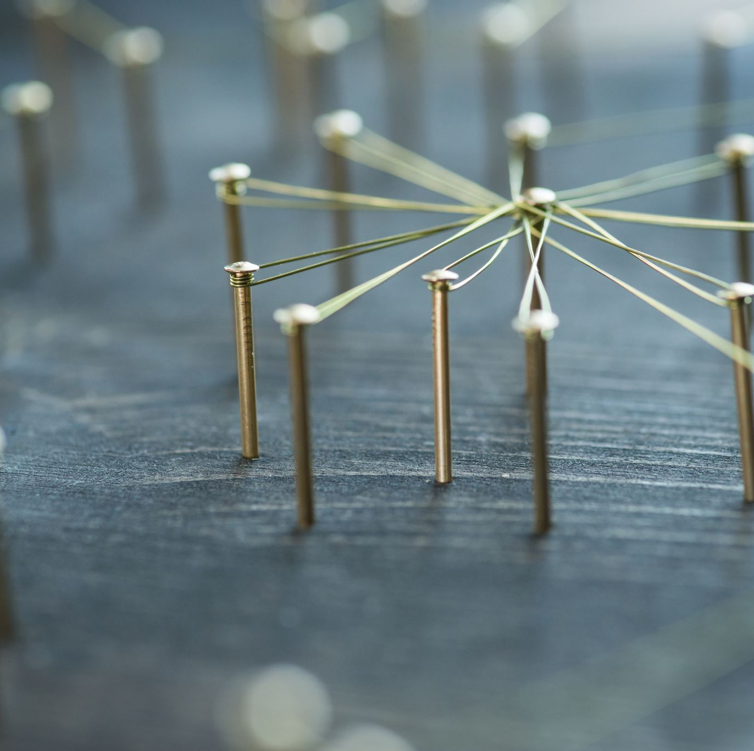
Discussion
To improve the model's performance, we could consider adding more convolutional layers to increase the model's capacity to detect features. We could also try different activation functions and optimizers, adjust hyperparameters, or fine-tune a pre-trained model.
Additionally, we could consider using more extensive and diverse datasets to improve the model's generalization ability. Finally, we could use techniques such as transfer learning and data augmentation to improve the model's performance further.

Slide 31

Conclusion
In conclusion, malaria detection using image processing is a promising approach that can help with the timely diagnosis and treatment of the disease. The presented code implements a Convolutional Neural Network (CNN) model, which is trained on a dataset of infected and uninfected blood cell images using ImageDataGenerator to perform data augmentation and reduce overfitting. The model achieved an accuracy of 93.4%, which is a good indication of its effectiveness in detecting malaria.
The code also demonstrates how to use the trained model to classify a new blood cell image as infected or uninfected. Additionally, several image processing techniques such as segmentation, Gaussian filtering, and Laplacian filtering are used to improve the accuracy of the model by preprocessing the images.
Overall, the presented code provides a practical and effective way to detect malaria using image processing techniques and deep learning. This approach has the potential to improve the accuracy and speed of malaria diagnosis, especially in resource-limited settings, where traditional diagnostic methods are not easily accessible. Further research can be done to improve the accuracy of the model and make it more suitable for real-world applications.

Slide 32

Acknowledgement
We would like to express our sincere gratitude to all those who have contributed to this project on "Malaria detection using Image processing". We would like to thank OpenAI for providing the resources and tools needed to develop this project.
We would also like to thank the authors of the papers and the creators of the datasets used in this project for making their work available to the public.
Furthermore, we would like to thank our teachers and mentors for their support and guidance throughout the project.
Lastly, we would like to thank my family and friends for their encouragement and understanding during the development of this project.

